Slide 1
Public meeting – Parking Proposals
20th September 2024

Slide 2
Purpose of Meeting
To cover the parking proposals and changes from last year’s proposal
To capture public comments and concerns on same to be shared with ELC
Please allow us to walk through the content, then we will open for discussion and ask you to raise your hand to manage comments and questions
Point of Note - Council Officials have been invited to attend this meeting. No acceptances were received.

Slide 3
The Proposal

Slide 4
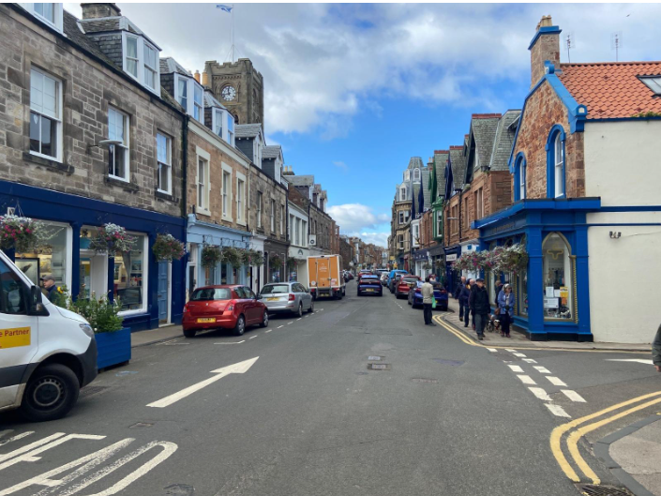
Background – As Stated by ELC
The 2018 Local Transport Strategy for East Lothian Council introduced the Parking Management Strategy. The focus of this strategy is to provide balanced and appropriate parking facilities that support the economic, environmental and accessibility requirements of towns in East Lothian. The Strategy also aims to maximise the efficient use of parking provision.
To support the Strategy, East Lothian Council is developing proposals to change the parking restrictions in North Berwick. The project will incentivise people to use more sustainable forms of transport such as the local bus network, cycling, wheeling or walking while also raising revenue to ensure parking can be fully enforced. After that, any remaining revenue will be reinvested back into the local [ELC] transport network and services.
The project requires a series of Traffic Regulation Orders (TROs) to change the parking restrictions in North Berwick

Slide 5
Previous Consultation History
In Autumn 2022 ELC consulted on proposals to introduce new parking policies in North Berwick. These included charging for on and off-street parking places, the introduction of Controlled Parking Zones (CPZ) that provided residential parking areas. The responses from the consultation were analysed and fed back into a review of proposals, which were then modified.
Council Officers reported to Elected Members at a full Council meeting in April 2023. Approval was given for Council Officers to move to the next stage of introducing a parking management scheme, progressing the TROs.
In August 2023, East Lothian Council gave notice that it intended to make TROs to amend enforceable waiting restrictions on various roads across North Berwick, and representations were received and analysed. Ultimately it was determined that the Draft TRO should be withdrawn to enable officers to integrate the feedback, and the proposals were again modified and four new draft TROs for enforceable waiting restrictions on various roads and car parks across North Berwick have now been published.

Slide 6
North Berwick Proposed parking management
Controlled Parking Zone in 4 Parts
Off Street Order ONE
Off Street Order TWO
Off Street Order THREE
On Street Order FOUR

Slide 7
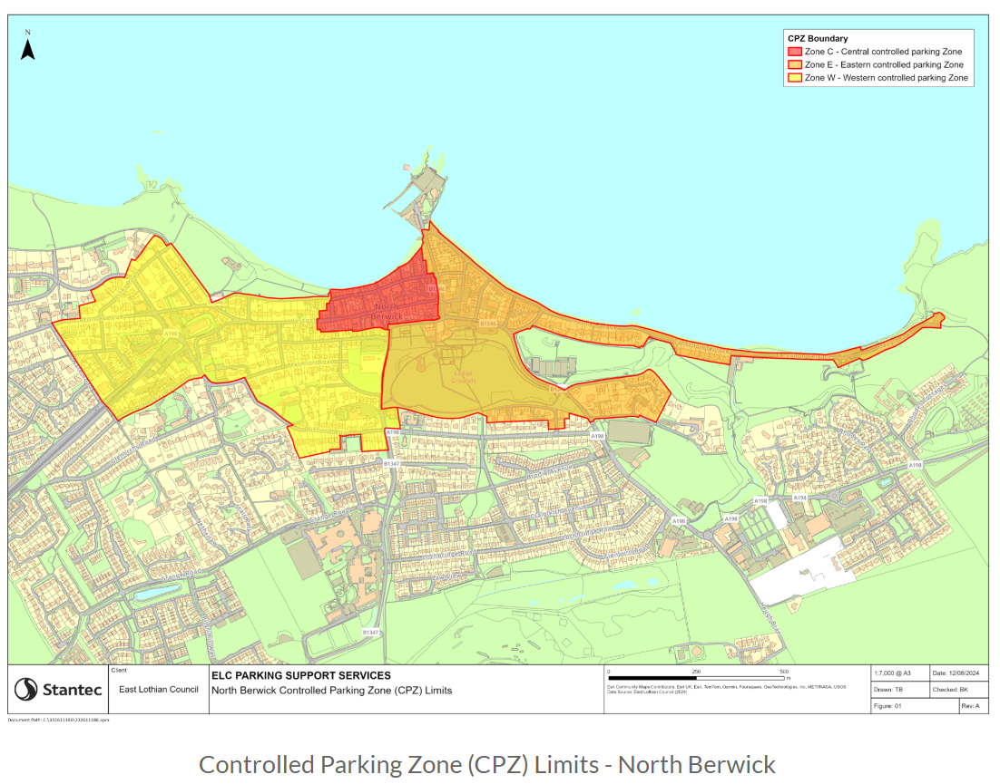
Controlled Parking Zone

Slide 8
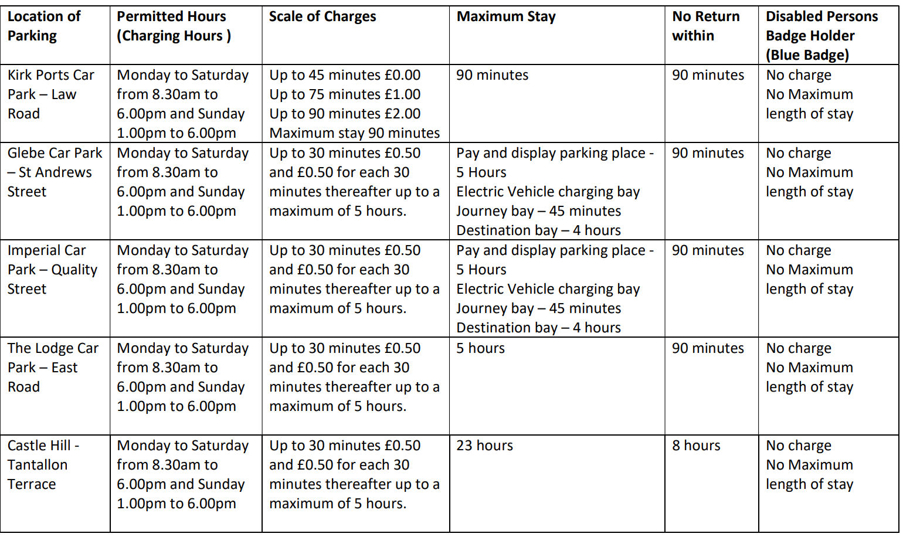
Off Street Order One

Slide 9
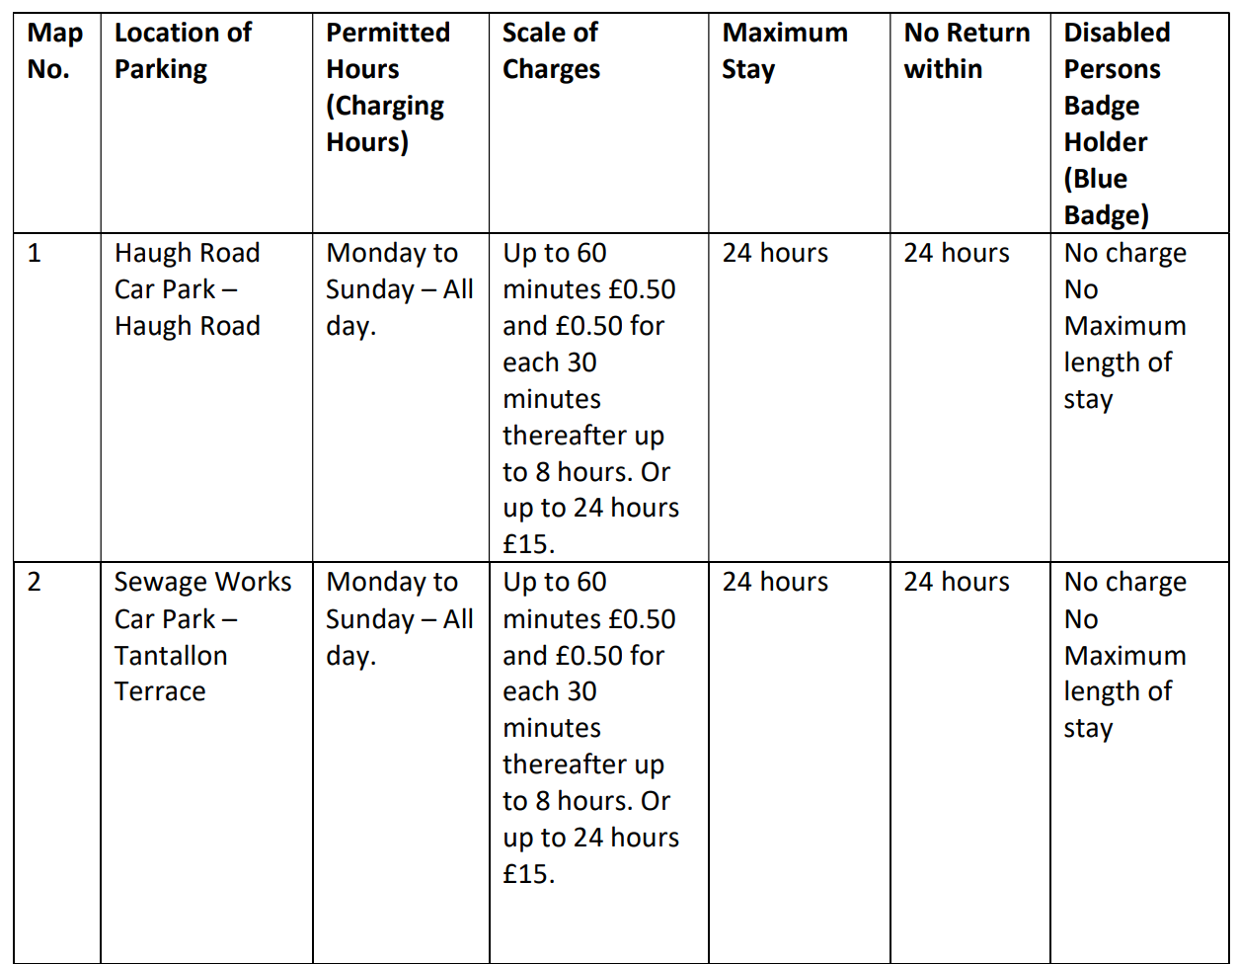
Off Street Order Two – Haugh Road & Sewage Works
Class Of Vehicle: Motor Car, Motor Caravan, Invalid Carriage and motorcycle

Slide 10
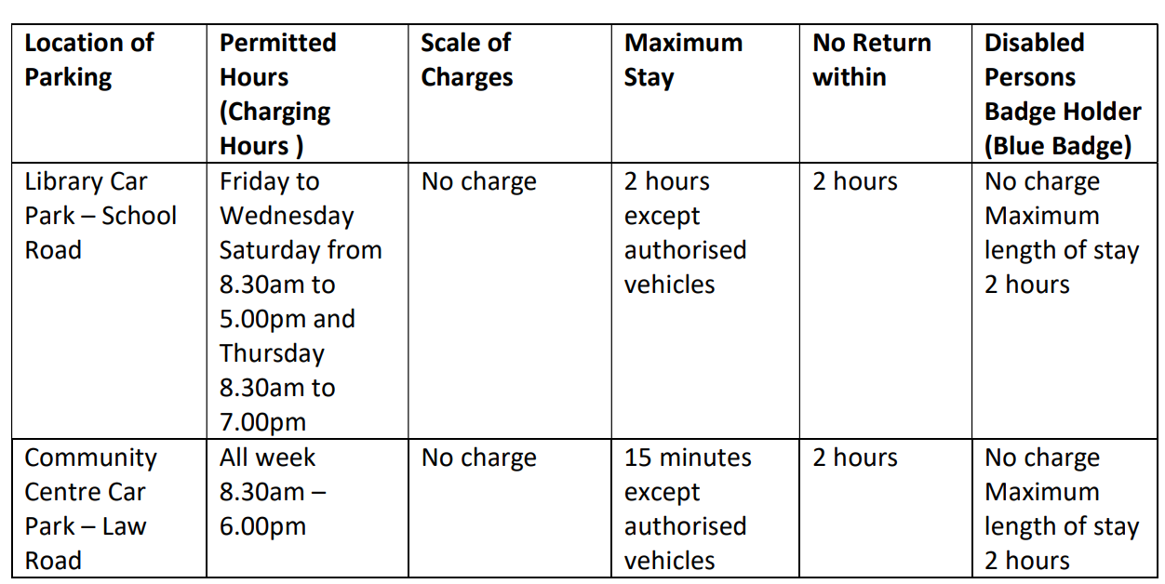
Off Street Order Three – Community Centre & Library

Slide 11
On Street Order Four
There are 11 separate maps showing the intended on-street parking restrictions in the various sections of the CPZ
To view these maps:
google: East Lothian parking management review
Follow the storymaps.arcgis link
Scroll down half the document to On Street Order 4, where you can view the maps, or even download them as a pdf file for closer inspection

Slide 12
The Basis of the proposal
2 separate days of parking studies in August
3 Footfall surveys in November
An economic impact assessment (in the Members’ Library)

Slide 13
The Economic Impact Assessment - Seasonal
Right in the introductory part: “There is substantial anecdotal evidence from the community and residents that there is a shortage of parking for residents and visitors to North Berwick. During the Summer months, parking demand often outstrips available capacity”
And under identified problems: “Significant seasonal parking problems linked to tourism.”

Slide 14
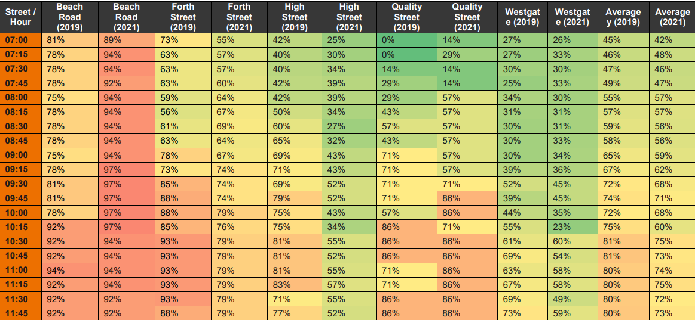
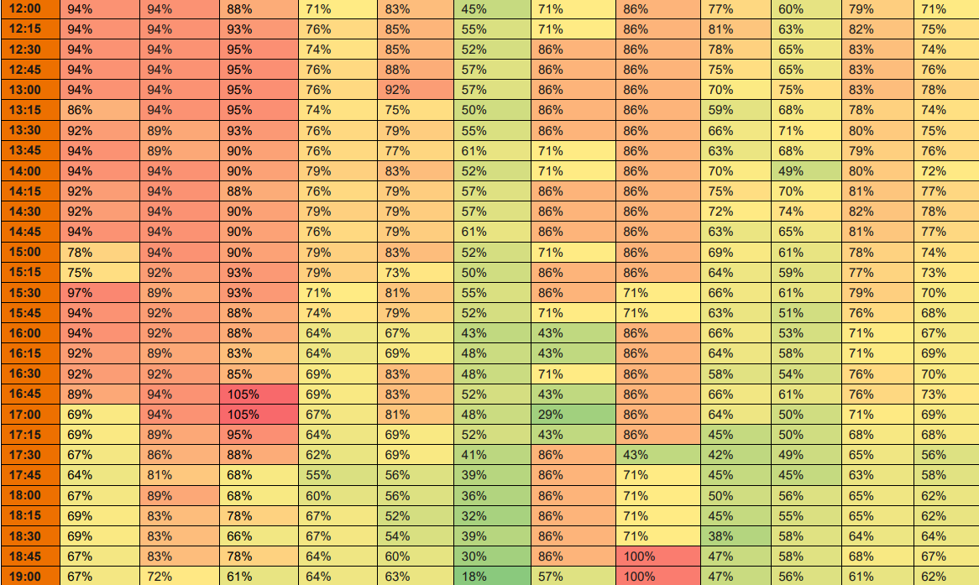
The Economic Impact Assessment - Occupancy
Average Occupancy of Parking Spaces
Beach Road highest with 81% / 89% at 7am – how many of them will still be there in the future, because they have parking permits? Most of them!

Slide 15
The Economic Impact Assessment - LTS
Reference to the Local Transport Strategy: “Key Point: The strategy highlights the need for parking intervention as a measure to encourage modal shift and to promote better travel behaviours” and the CPZ scheme is meant to be an incentive to use more sustainable travel choices, but:
No additional public transport is provided to provide alternatives to car use for people living outside walking distance to their destination.
The use of bicycles is in a town with NB’s topography only possible for the youngest and fittest.
And only some of the young and fit living in the vicinity of the town centre may be encouraged to walk more often rather than to use their car.

Slide 16
The Economic Impact Assessment
Identified Problems
Significant seasonal parking problems linked to tourism. Insufficient on and offstreet parking supply and poor turnover of spaces leading to on-street overflow parking affecting residential parking
Note the word seasonal (again)!
On-street overflow parking around The Glebe car park and North Berwick railway station
Both will get worse, just move a bit further away
Lack of enforcement of parking restrictions leading to deliberate violation
Yes, we will get more parking wardens
Lack of provision for long-stay parking creating long-stay on-street parking
No new long-stay parking created, so problem only moved to residential street

Slide 17
The Economic Impact Assessment
Identified Problems
Lack of Blue Badge parking on High Street
2 new blue badge spaces
Changes to the use of blue badges in the High Street. This is not new Blue Badge spaces. Blue Badge spaces are bigger by design for a reason.
Retailers experiencing difficulties with deliveries including abuse of loading bays and double parking on the carriageway
The only protection against that is the increase in parking wardens (but retailers get even fewer loading bays in the East End)
Signage to off-street car parks could be improved
Is there any provision for that in the TRO?
Short-term on-street problems at peak school travel periods around schools
Not at all affected by the TRO

Slide 18
The Economic Impact Assessment
Charrette
Reference to the Charrette:
“Key Point: The North Berwick Charette identifies parking problems within the town and also identifies socially acceptable interventions”
→The main Charrette recommendation for the East End of the High Street is to be thrown out!

Slide 19
The Economic Impact Assessment Impact on shops
6.4.2 A key concern for local businesses is that parking restrictions and any reduction in parking spaces as a consequence of proposals on the east end of the High Street will lead to financial loss as the market share for cyclists and pedestrians is much lower. This is due to perceptions that most visitors to shops travel by car rather than walking or wheeling.
6.4.3 However, the evidence suggests that retailers over-estimate the contribution of drivers to footfall.
Question: And where is this evidence from?
Answer: From Bristol, where 42% of customers lived within half a mile,
not 12% as retailers believed,
and Toronto, where 10% of customers arrived by car –
like comparing NB with London!

Slide 20
The Economic Impact Assessment
Estimated Mode Shares in 10 Scenarios
(Quite apart from the very small changes in mode share, the “Assumed Modal Shift” appears to be total nonsense)

Slide 21
The Statement of Reasons

Slide 22
Introduce appropriate areas for a small number of visitors to make overnight stops in motorhomes
The order mentions allowance for overnighting motorhomes in designated bays on Sewage Works & Haugh Car Park, but provides no further details on number of bays and there is no plan for appropriate facilities.
Order 4 states:
“(d) No Caravan, Trailer or motor caravan shall use a parking place unless the prior written consent of East Lothian Council has been given.
(e) No person shall use any part of a parking place or any vehicle left in a parking place:-
(1) For sleeping or camping purposes
(2) For cooking purposes
(3) For the purpose of washing any vehicle other than is reasonably necessary to enable that vehicle to leave the parking place.”
But how do you communicate such detailed information to visitors throughout the CPZ?

Slide 23
Reduce inappropriate and indiscriminate parking which can cause inconvenience and congestion
The only way to reduce inappropriate parking is the increase in parking wardens,
but nothing in the CPZ scheme itself

Slide 24
Enable better management of the limited parking space available in the town
The CPZ scheme does not create any additional parking space, but only reorganises the existing space.
Parking space is more limited than demand requires only in the peak summer months. There is not a shred of evidence that there is a shortage of parking spaces all year round.
During the summer the main parking problems are created by visitors coming for much of the day to go to the beaches, and then also go into town for a stroll or an ice cream or a meal. These visitors therefore currently do not make much use of any parking spaces in the High Street, but use space in residential streets or by the recreation park. This will not change. But the prospect of being charged for parking will make many visitors think twice about coming to NB, and stay in Gullane or Portobello instead.

Slide 25
Provide convenience and improved parking opportunity for residents who are currently affected by high demand for parking spaces at peak times - 1
In the original survey more than two thirds of the respondents, who lived within a future CPZ, rejected the CPZ concept! They clearly do not perceive the proposal as an improvement to their current situation.
Only very few streets have purely residential parking, amounting to 683 m in total providing space for just over 100 cars on total, mainly around the train station.
The vast majority is combined parking for residents and charged parking.
Residents in the East Zone have no advantage whatsoever by paying £40, because all spaces there are for combined parking, and the parking permits do not even allow use of the Imperial or Lodge car park.

Slide 26
Provide convenience and improved parking opportunity for residents who are currently affected by high demand for parking spaces at peak times - 2
Furthermore, in much of the East Zone is Schedule 14, with charges at either level 3 or 4. At level 4 the limit to parking duration is 23 hours, with only a maximum daily charge of £5.00 allowing visitors to stay all day. At level 3, there is a 6 hours restriction, except for permit holders.
The east zone residents are significantly disadvantaged as this is the smallest geographic area, but is the most densely populated due to the number of flatted properties.

Slide 27
Increase turnover of vehicles parking in the town, providing easier access to businesses and shops - 1
Capacity increases in car parks changing from long-term to 5 hours:
in Imperial and Lodge with 70 and 21 spaces, mainly at the expense of residents;
in the Glebe with 77 spaces, mainly at the expense of businesses and employees.
High Street
The existing 90 minute limit still applies.
45 minutes are free, the next 30 mins cost £1.00 and the next 15 minutes another £1.00. This is very limited incentive to increase turnover, when the current average parking time during business hours is already below 25 minutes.
But the need to get a ticket, even for the free 45 minutes, will reduce turnover.
Further reductions in turnover:
The extension of the permitted parking time in the Kirk Ports car park from 60 to 90 minutes for 22 spaces;
In Westgate 80 spaces changing from the current 90 min limit with a current average parking duration under 40 minutes replaced by combined permit and paid 6 hour parking.

Slide 28
Increase turnover of vehicles parking in the town, providing easier access to businesses and shops - 2
The need to get a parking ticket even by app will add a couple more minutes to each stay and, for those having to get a ticket from a machine, even for a quick errand, will not only add even more minutes to the parking time, but deter many from coming to the High Street in the first place, and go to Aldi or Tesco, or order from Amazon instead.
The scheme will increase turnover to some extent by preventing High Street employees parking near their place of work all day, but this will make it even more difficult for anyone outwith walking distance to be able to take on a job in North Berwick town centre, when local business is already fighting with staffing problems.
In Berwick-on-Tweed the introduction of parking charges killed the town centre, and has since been revoked – but too late to save the centre
2 hours free parking has been re-introduced in Ayr Town Centre ‘to help increase footfall in the town and boost the local economy’.

Slide 29
Increase turnover of vehicles parking in the town, providing easier access to businesses and shops - 3
Aldi and Tesco are easy alternatives for food shopping
Amazon delivery vehicles are already noticeable all over the place
A number of High Street retailers have already announced they will not extend their lease, if this scheme goes ahead
The risk that our High Street, now the “Jewel of the Crown” and – in its current state! – specifically highlighted by The Times as one of the reasons why North Berwick is the best place to live in the UK, reverts back to the poor state it was in 20 years ago is very real.

Slide 30
Increase turnover of vehicles parking in the town, providing easier access to leisure facilities
Access to the West golf course for members living outside walking distance will be severely impacted by a charge of £5.00 for every round of golf. For members playing twice a week the charge will amount to £500.00 per year. Which is not easily affordable for everyone!
Access to swimming pool and leisure centre could be reduced when day visitors use that car park in the summer months, when the recreation park is full, as one of the nearest places, where they can stay without charge.

Slide 31
Not Considered in Statement of Reasons - 1
3 parking zones with all different rules and regulations will be confusing for residents, but even more so for visitors, and many inadvertent violations are to be expected.
Guest of residents in CPZs will have to pay for parking, possibly discouraging visits, with the infirm and elderly possibly worst affected. In other CPZs it is usual that residents have passes that can be filled in for their guests’ cars.
Commitment in Stantec’s approach to simplify this. Instead of 1 TRO we now have 4, giving us 3 zones with different rules. Where is the simplification?
Owners of short term lets will be able to apply for visitors permits, but only a maximum of 25 per year. Each one lasts a week, so leaves 27 weeks a year where the occupants will not have a visitors permit, and will therefore have to pay full parking charges and be restricted on how long they can park.

Slide 32
Not Considered in Statement of Reasons - 2
Machines to pay for parking will be obstacles on the pavement.
Care worker permits are also available (to be paid for by whom?) but these do not guarantee a Care Worker a space
The station car park will be permanently full with residents without permits, their guests and other visitors. Train users will find it impossible to park there for much of the time, and commuters cannot even pay for parking in the vicinity due to the 6 hour limit. They will therefore have to park way up Glenorchy Road, Ware Road, or Highfield Road, and possibly miss their train, if they have to walk even further than expected, and in any case make train access very difficult for people with mobility issues,
There will be severe spillover effects on roads just outside CPZs. Streets like Glenorchy Road, Ware Road, York Road, and in particular St Baldreds Road, will become parking hot spots, which will not only create new problems for residents there, but, even worse, certainly create severe problems for access to the surgery.
Dirleton avenue is not restricted in the TRO’s, but is not currently double yellow lines, so will become part of the overspill from the CPZ restrictions. We know how much impact a single car has parking there.

Slide 33
Where to find the Traffic Order:
https://northberwickparking.commonplace.is/en-GB/proposals/document-library/step1
How to object:
Any objection must be in writing and must specify the grounds thereof and should be addressed to:
North Berwick Parking Management TRO, Asset and Regulatory Manager, Road Services, Penston House, Macmerry EH33 1EX
Or Email
roadsconsultation@eastlothian.gov.uk quoting reference North Berwick Draft TRO by 29th September 2024
Contacts for local ELC Councillors:
Jeremy Findlay – jfindlay@eastlothian.gov.uk
Liz Allan – lallan2@eastlothian.gov.uk
Carol McFarlane – cmcfarlane1@eastlothian.uk

Slide 34
Frequently Asked Questions
East Lothian Parking Management Review (arcgis.com)

