Slide 1
2 Things to Note to Start with

Slide 2
Council Officials have been invited to attend this meeting,
but none of them agreed to come

Slide 3
Our petition against the proposal had 4,504 signatures
It was rejected by ELC on technical grounds
ELC claims we cannot resubmit it, while we heard the opposite from the Provost → Watch this space ………….

Slide 4
The Proposal

Slide 5
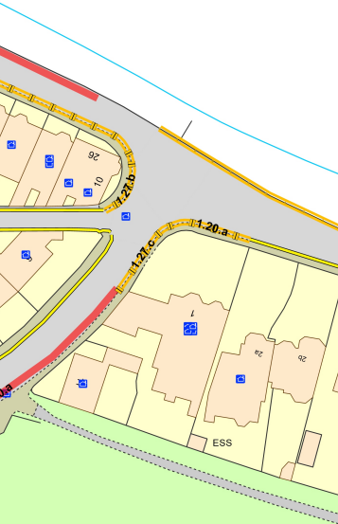
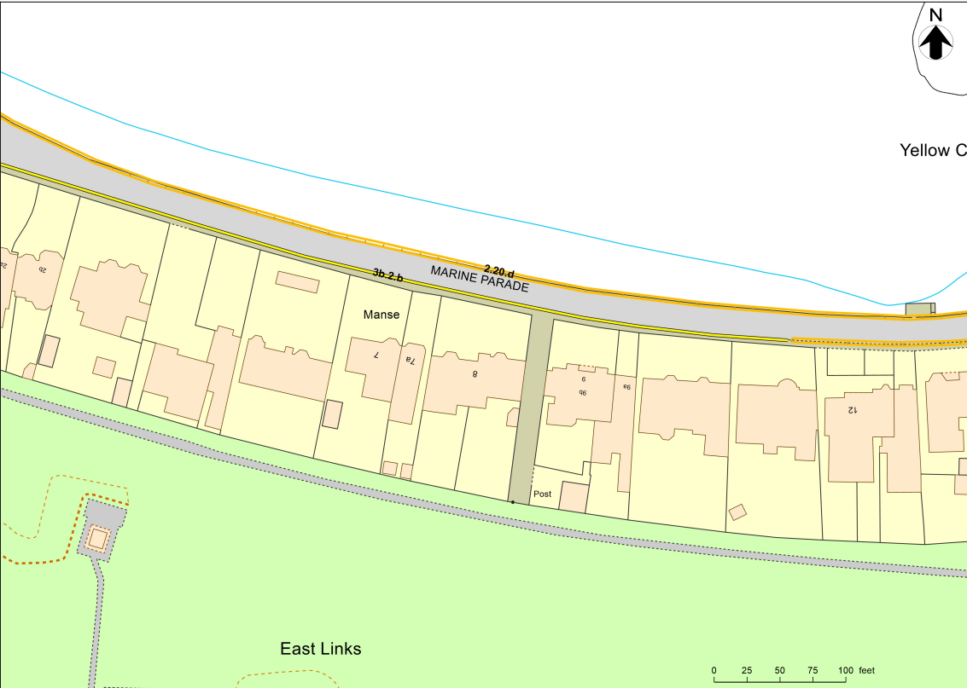
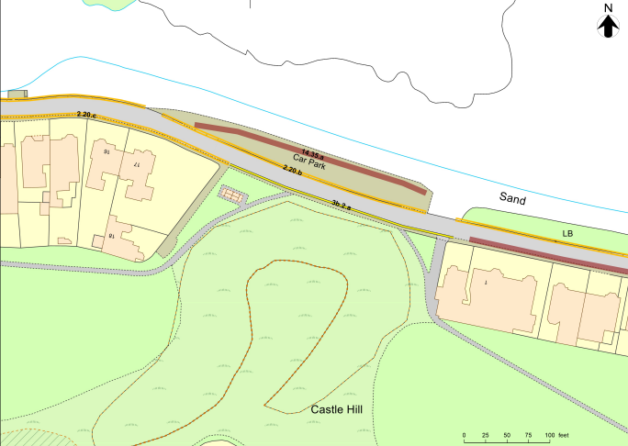
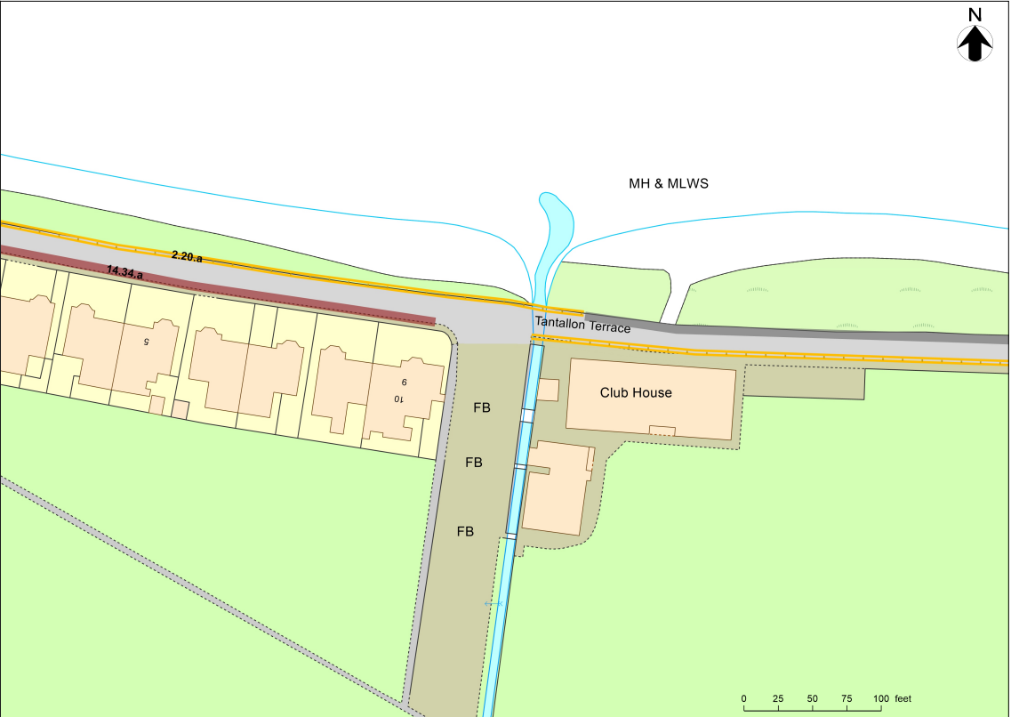
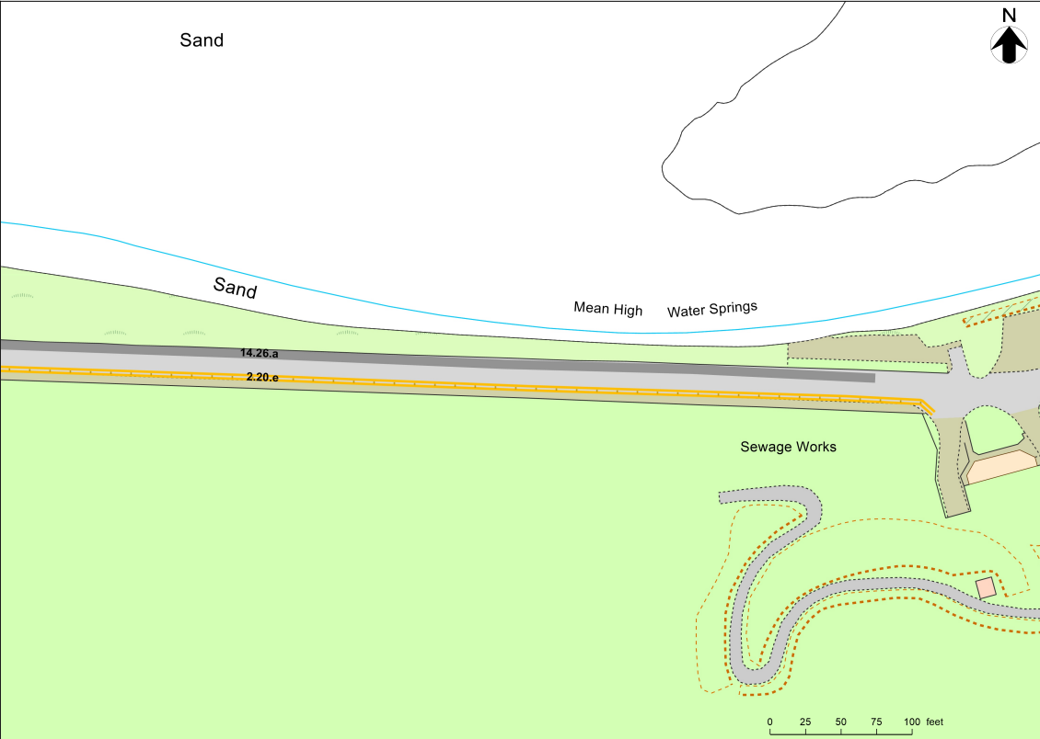
Tantallon Terrace and Marine Parade

Slide 6
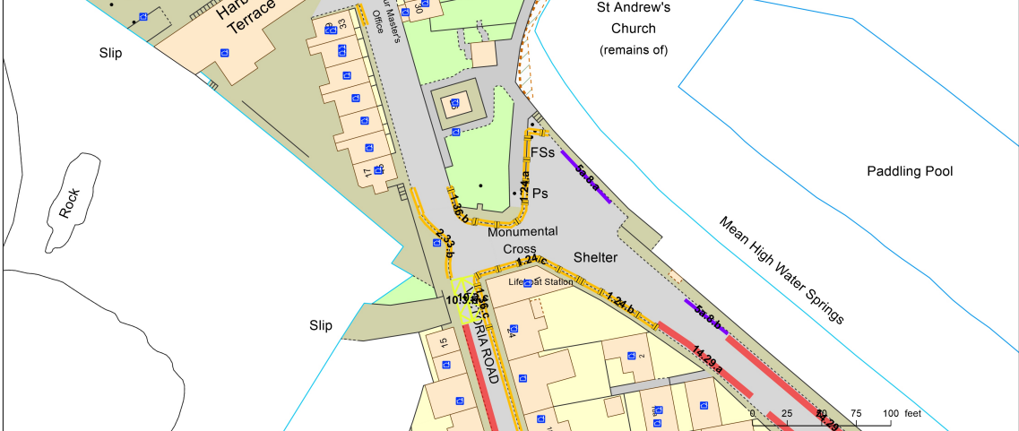
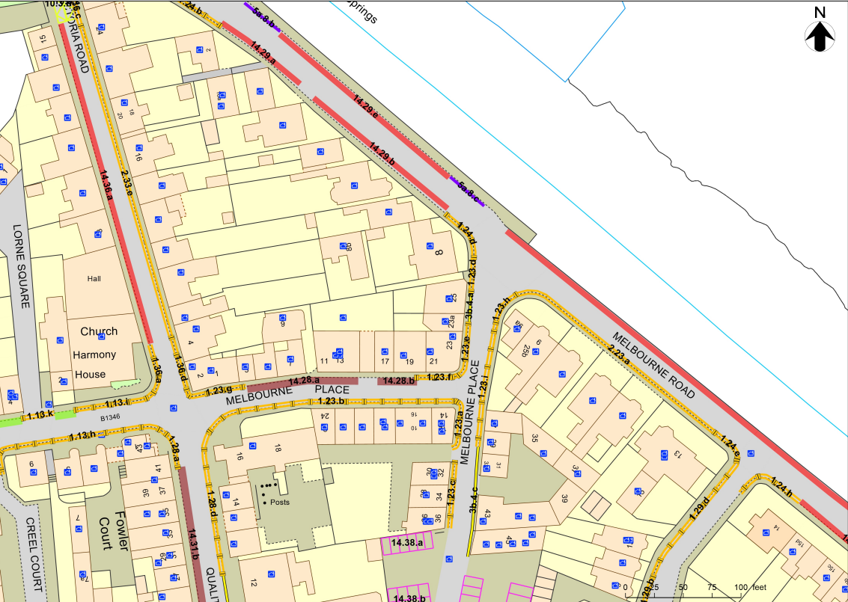
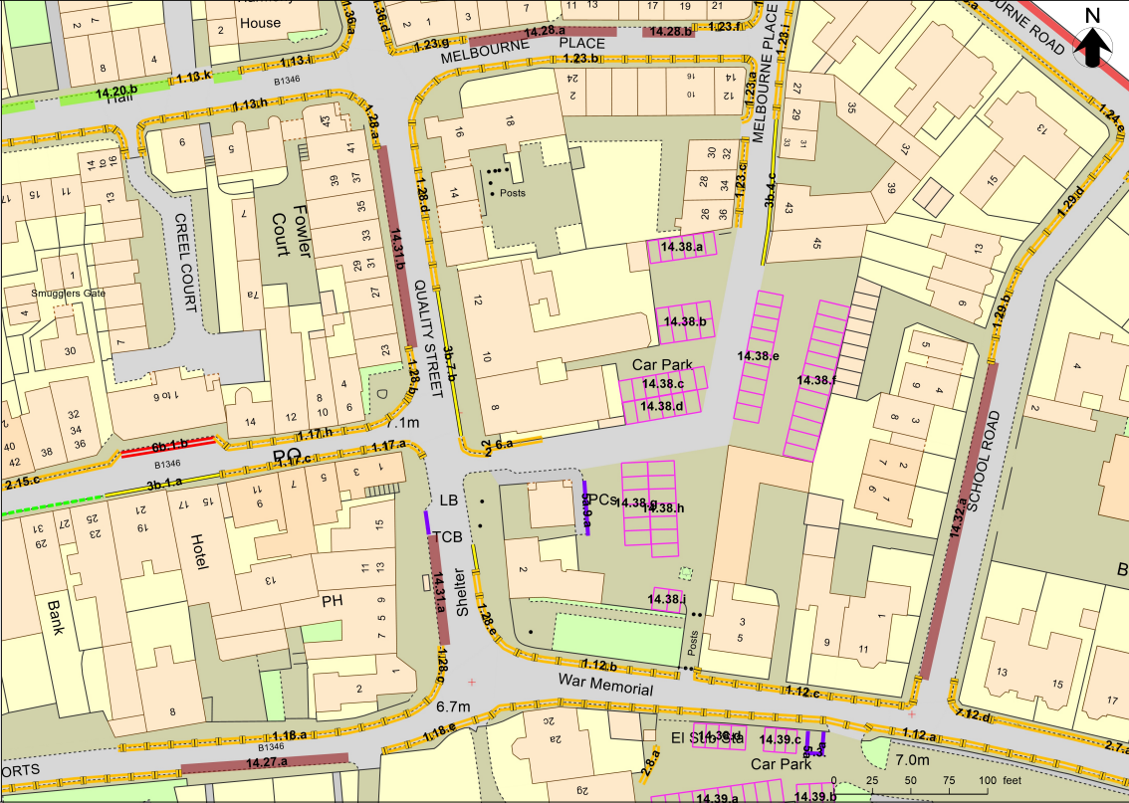
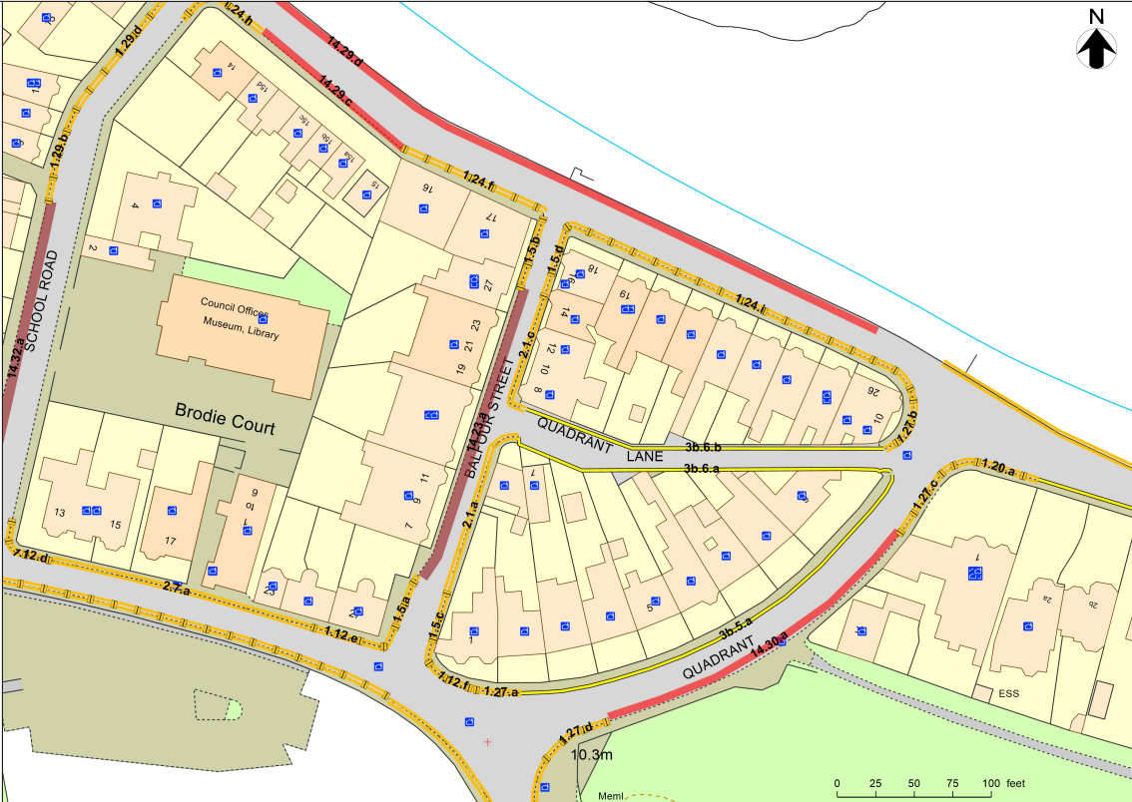
Northern East Zone

Slide 7
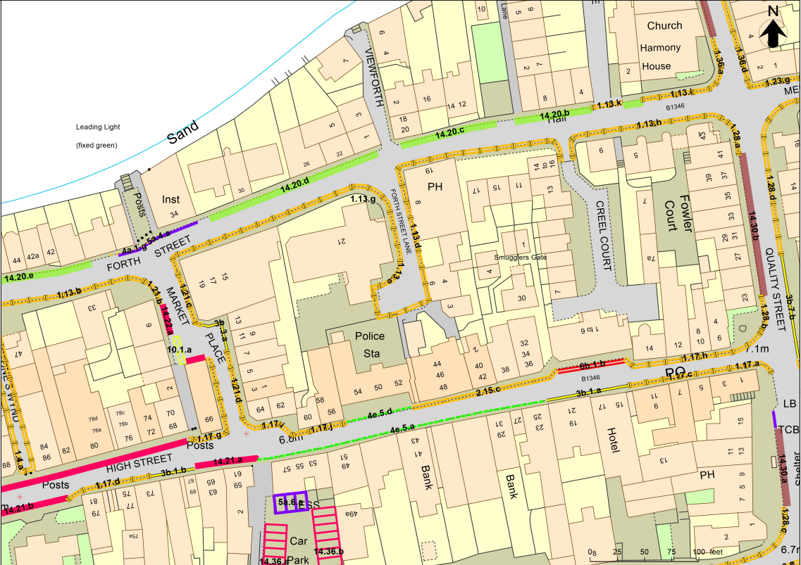
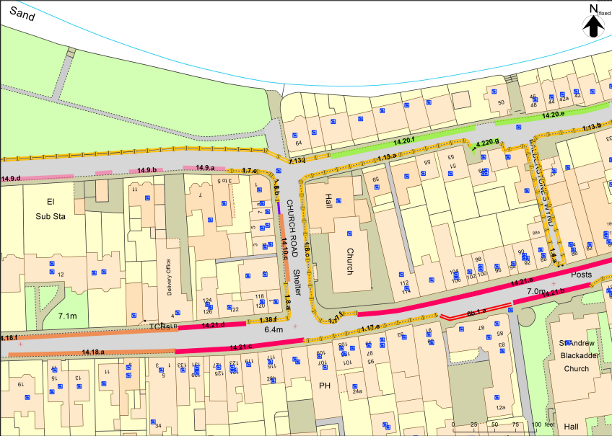
Forth Street and High Street

Slide 8
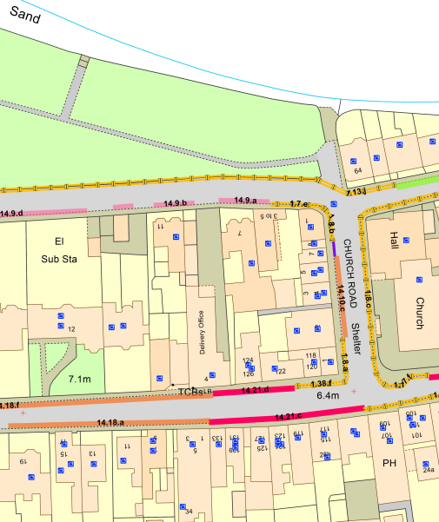
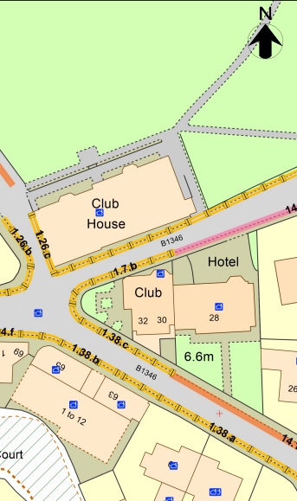
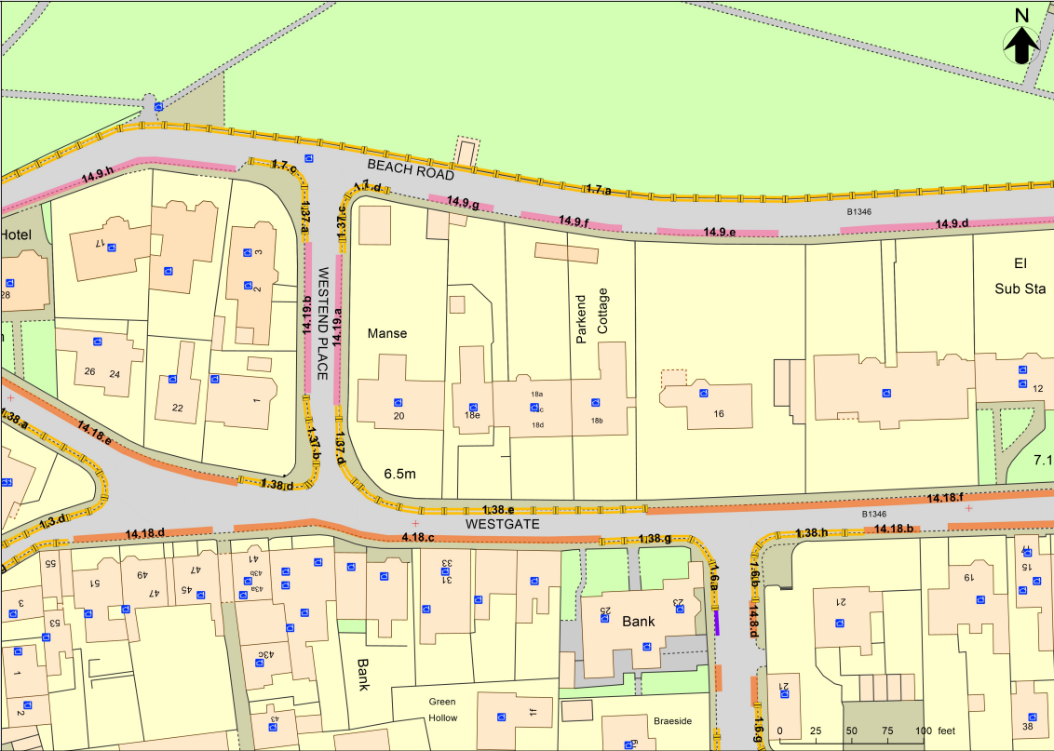
Beach Road and cross roads, Westgate

Slide 9
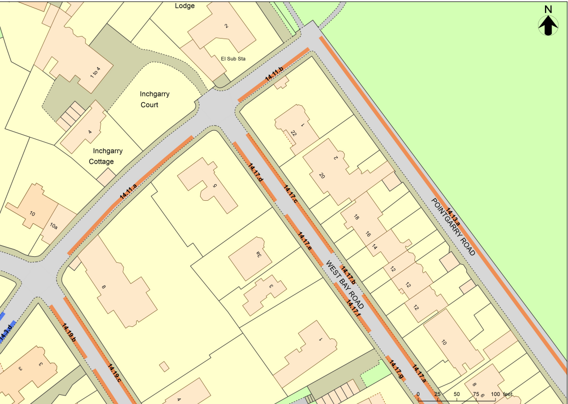
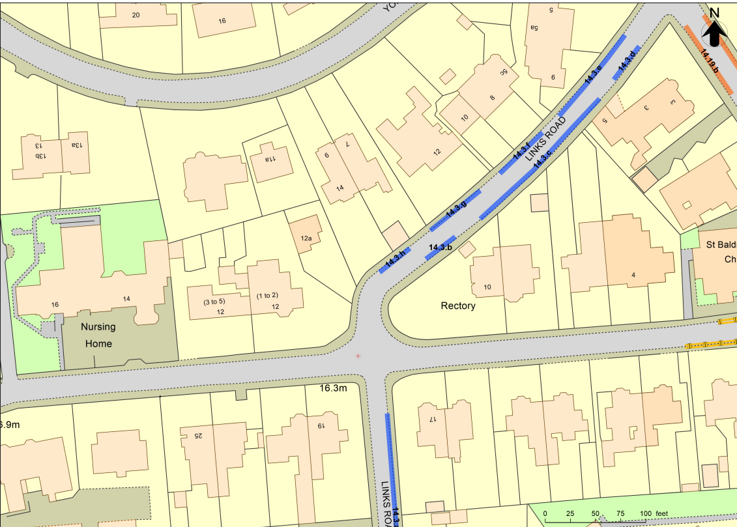
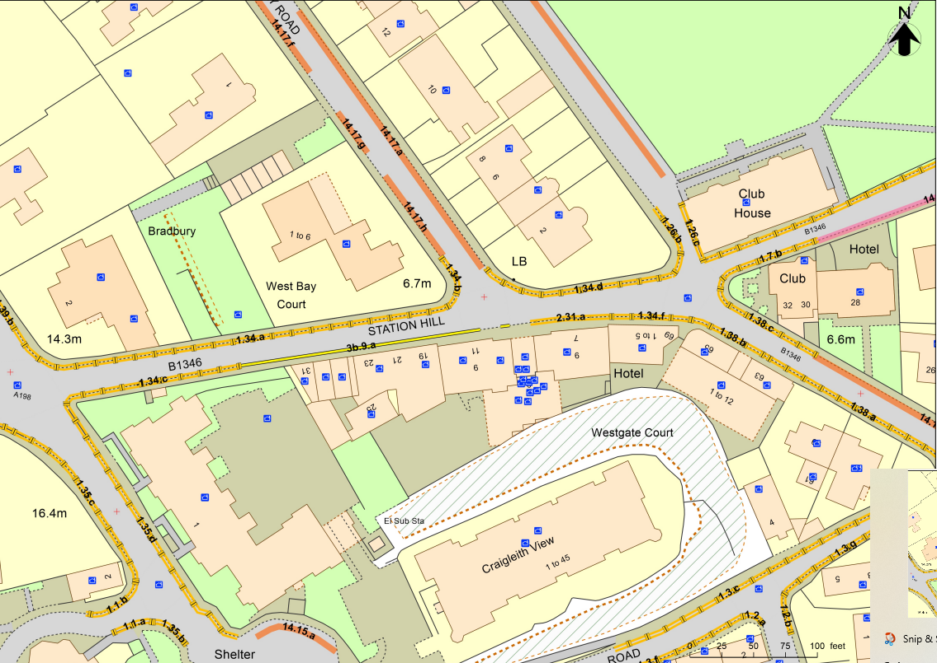
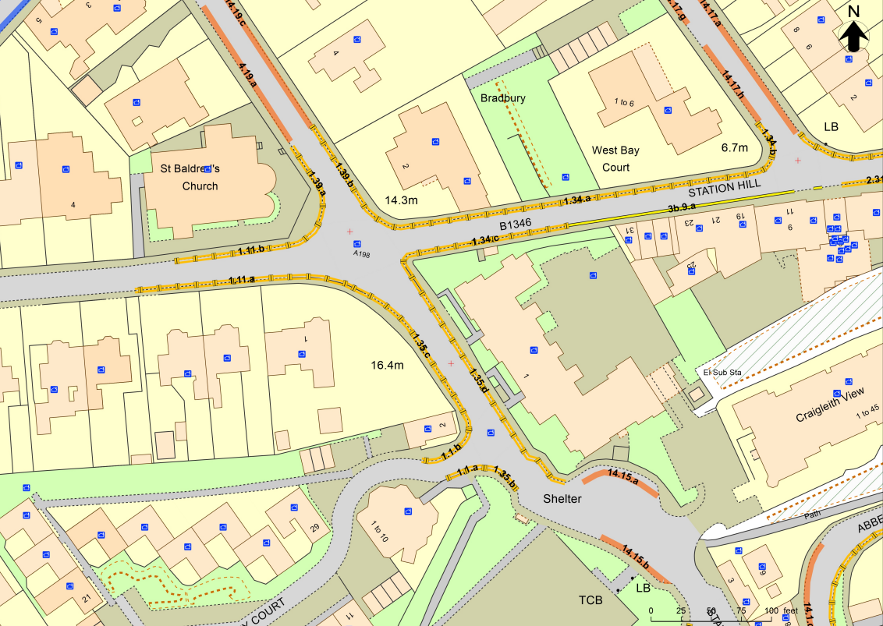
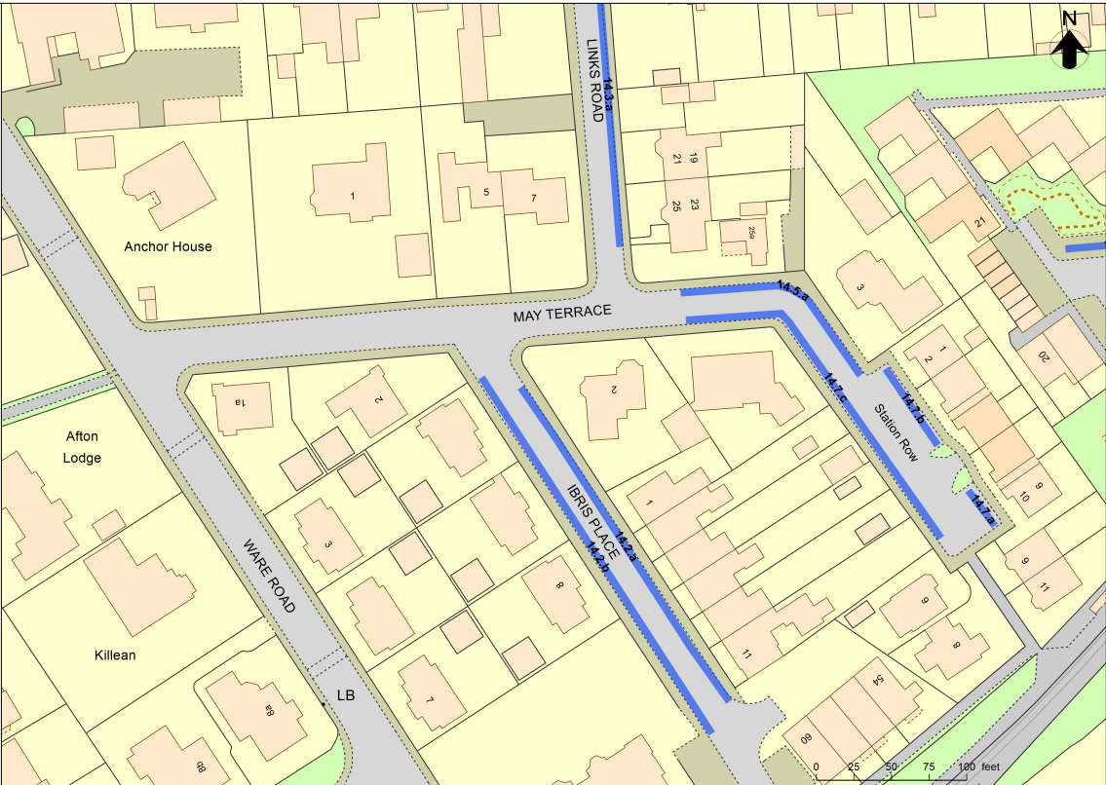
Northern West Zone

Slide 10
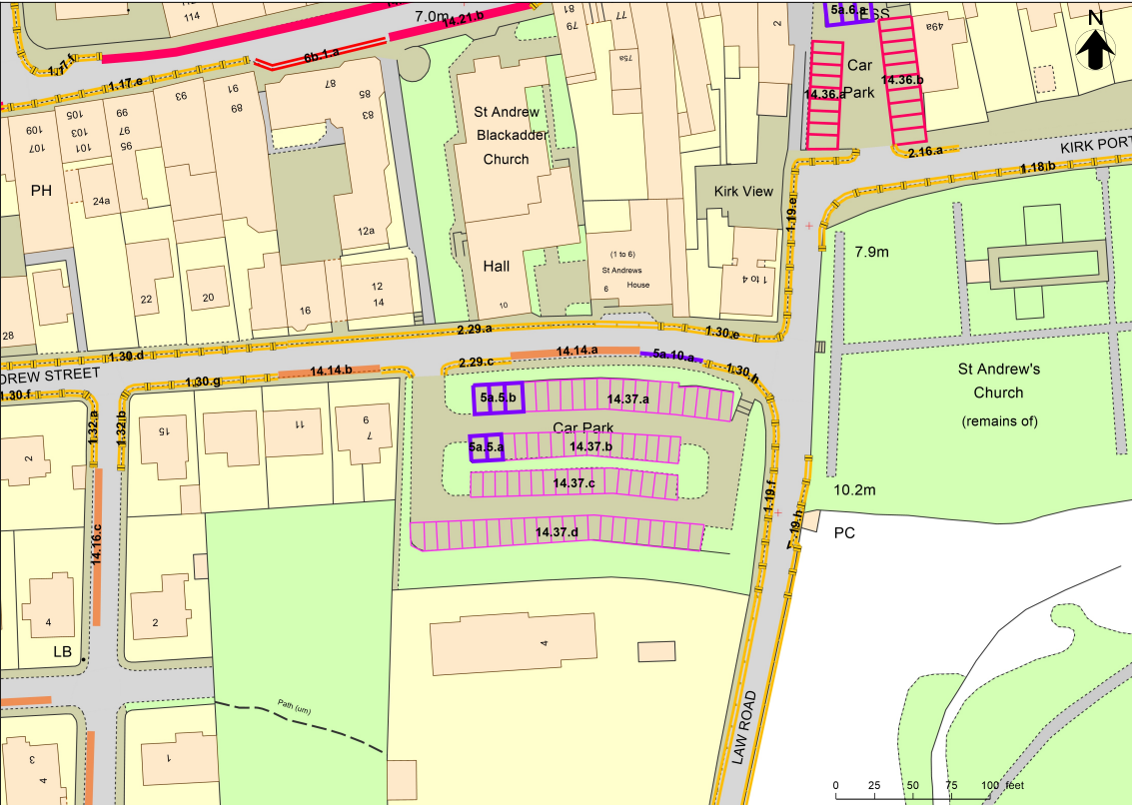
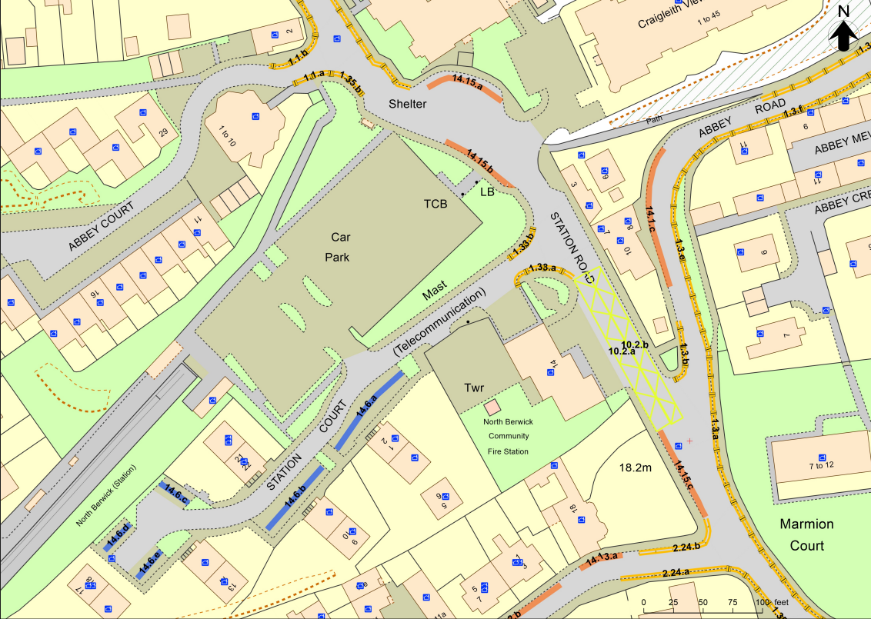
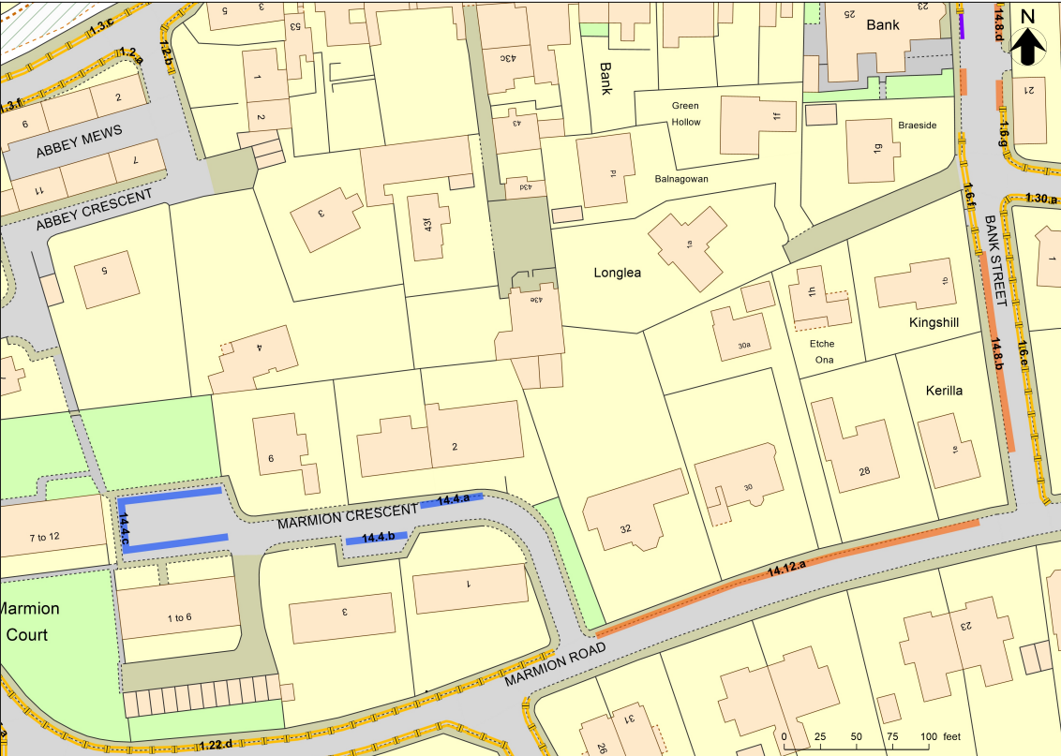
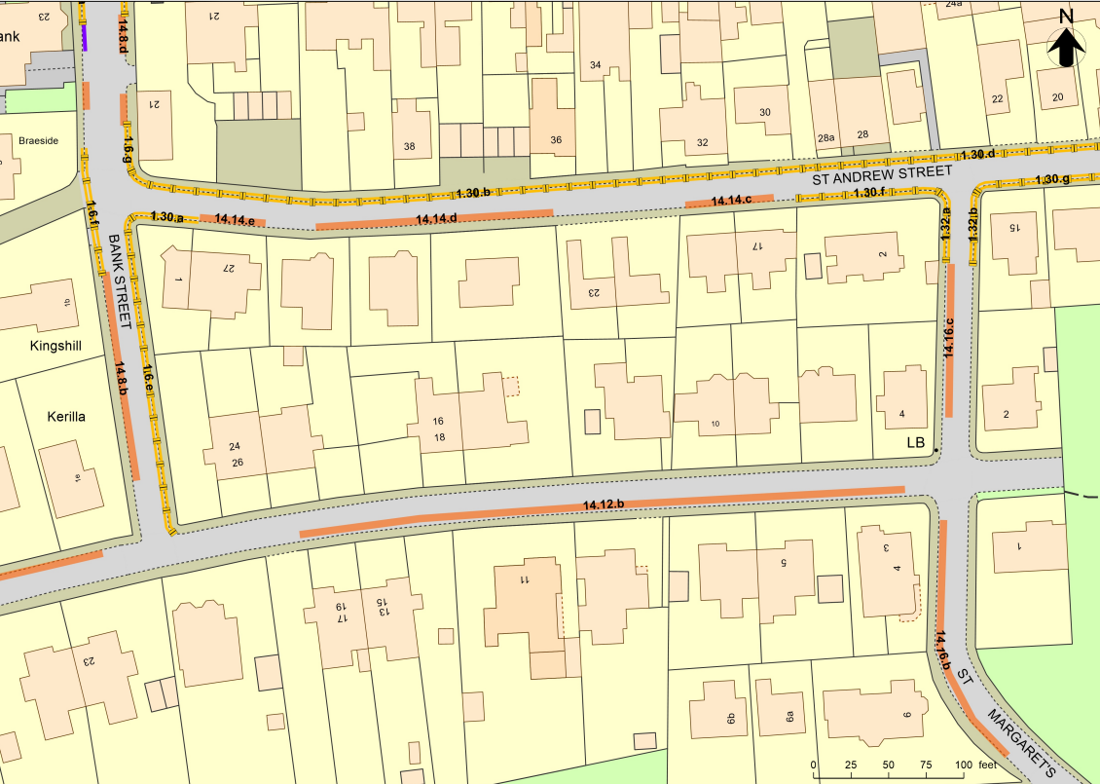
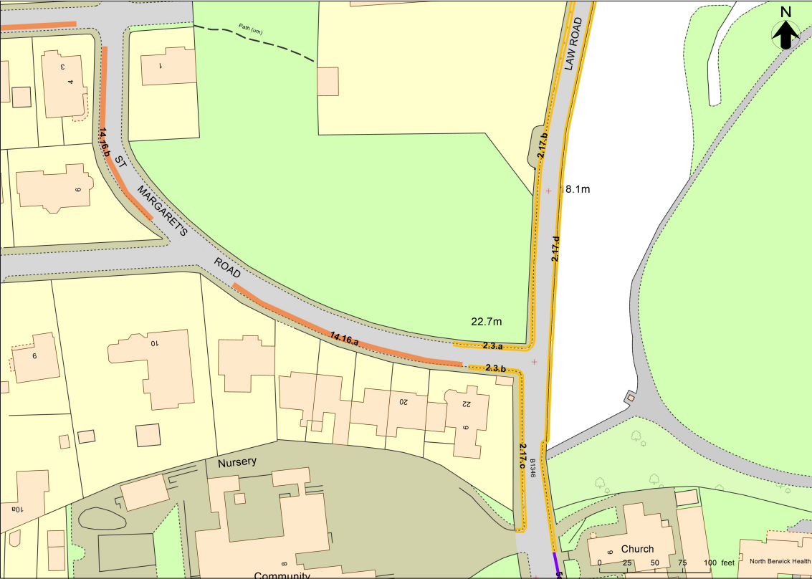
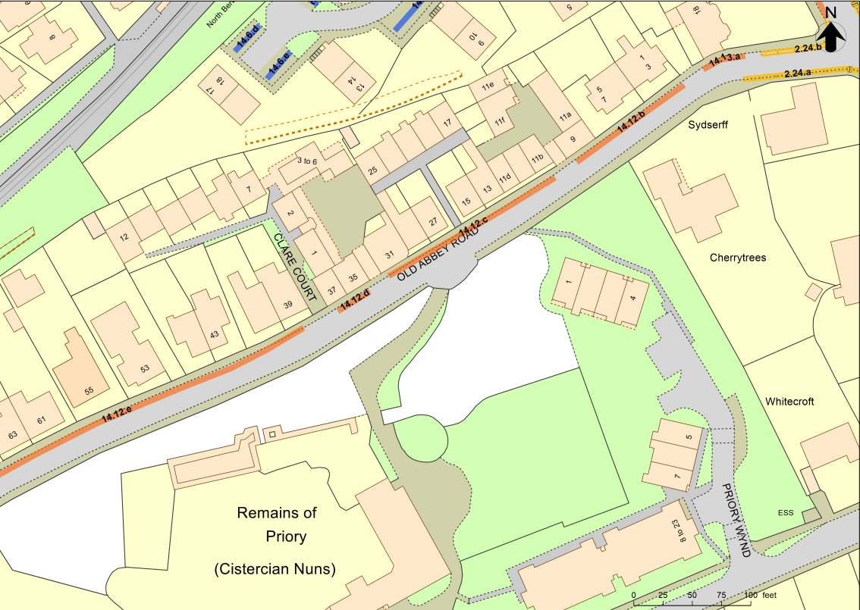
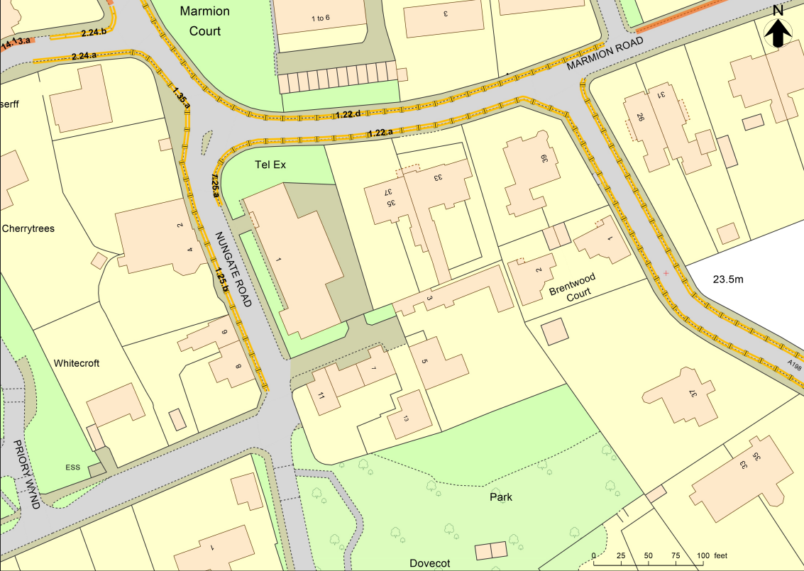
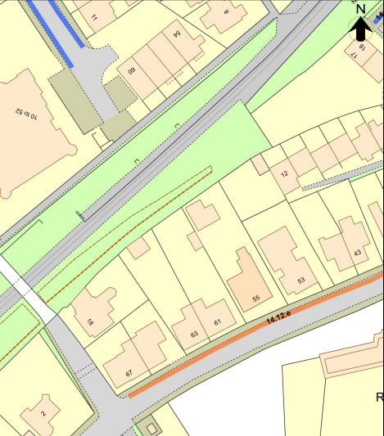
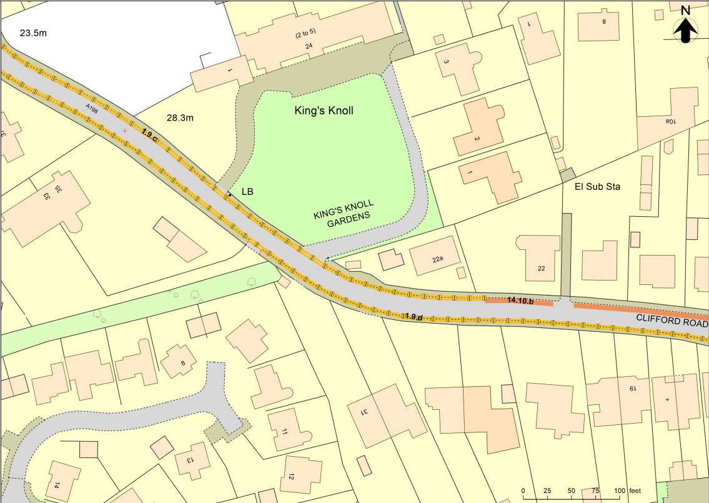
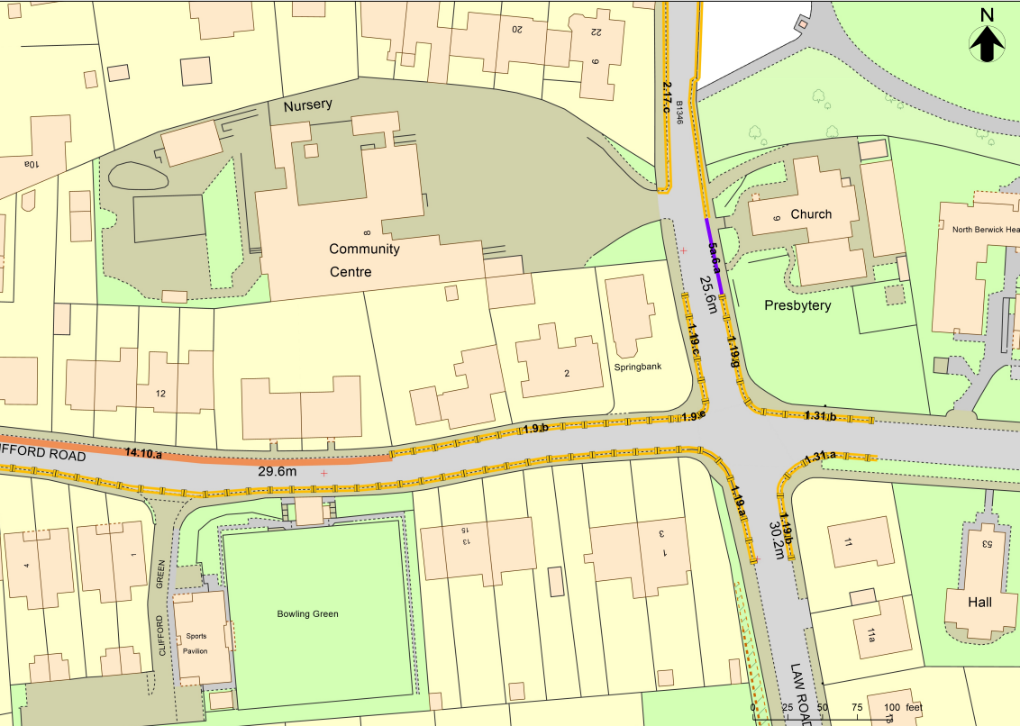
Southern West Zone

Slide 11
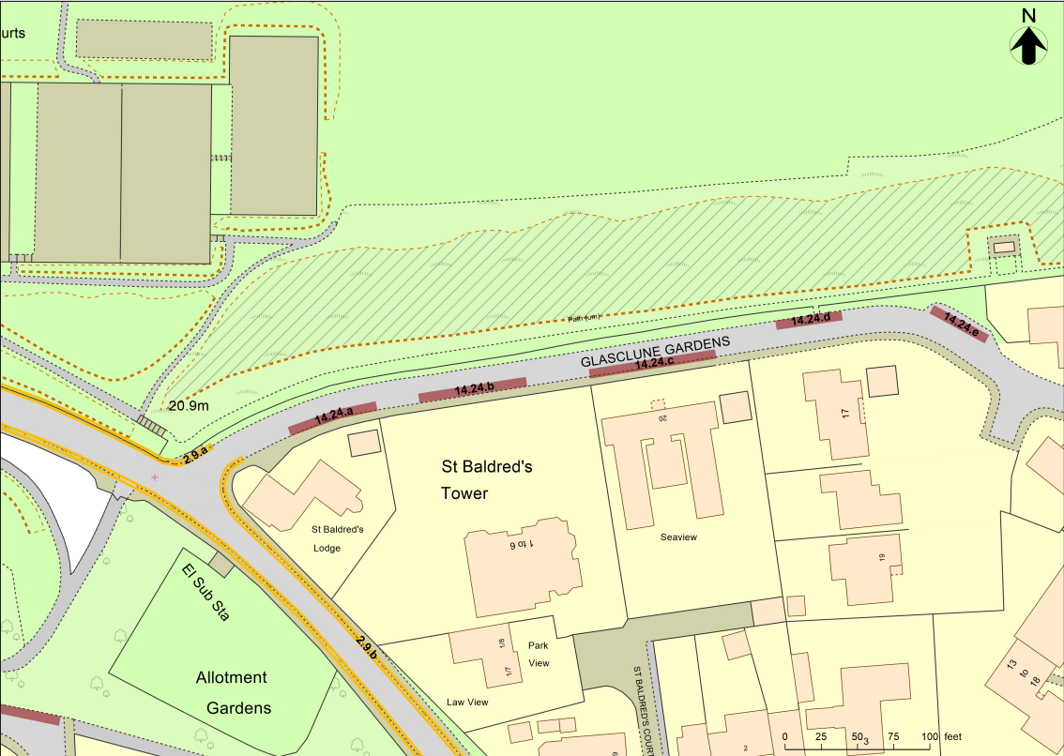
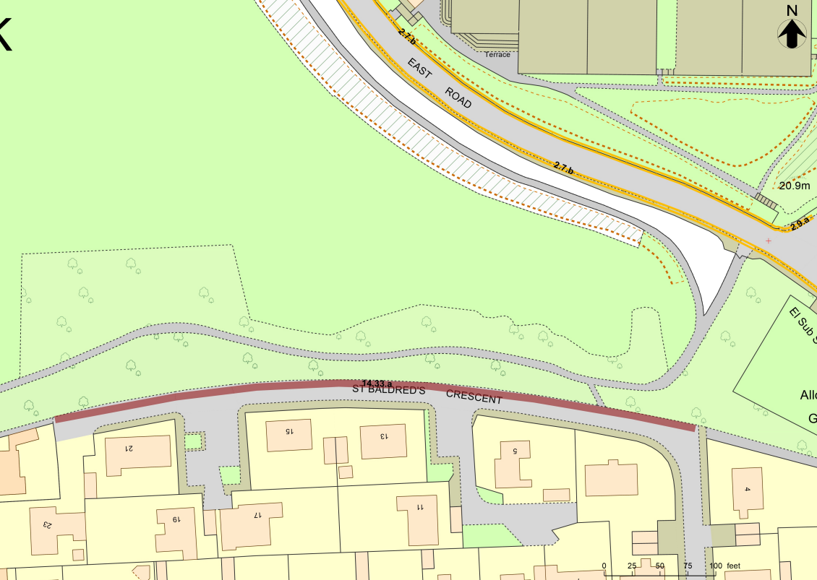
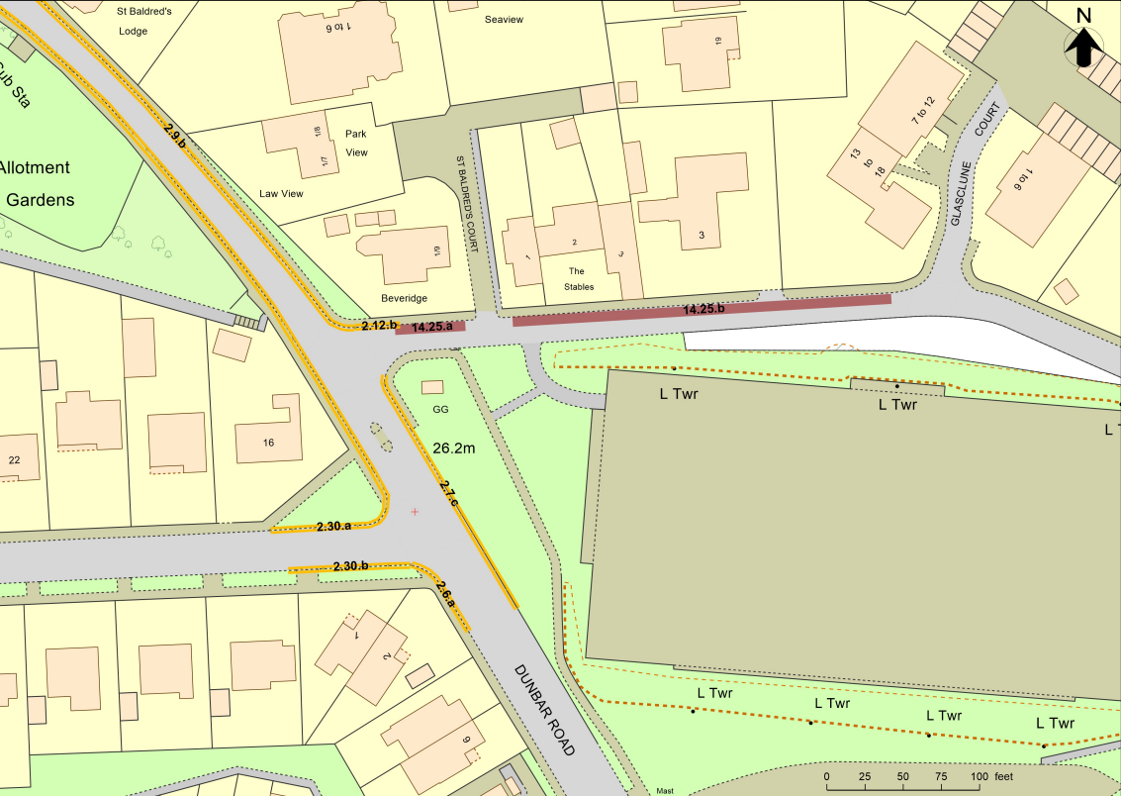
Southern East Zone

Slide 12
The Basis of the Proposal
Traffic Surveys carried out in 2019 and 2021
2 Parking surveys, both in August
3 Footfall surveys in November
An economic impact assessment (in the Members’ Library)

Slide 13
The Consultation
Even the main Council Official in charge admitted in a meeting with NBCC that the consultation had been flawed, and that they must do better in the next consultation in Musselburgh!
Closed Questions
Very limited chance to comment
Only one question whether NB has a parking problem: yes or no?
The survey allowed multiple responses from the same person, and even inviting respondents in the end to fill in the survey again!

Slide 14
The Economic Impact Assessment - Seasonal
Right in the introductory part: “There is substantial anecdotal evidence from the community and residents that there is a shortage of parking for residents and visitors to North Berwick. During the Summer months, parking demand often outstrips available capacity”
And under identified problems: “Significant seasonal parking problems linked to tourism.”

Slide 15
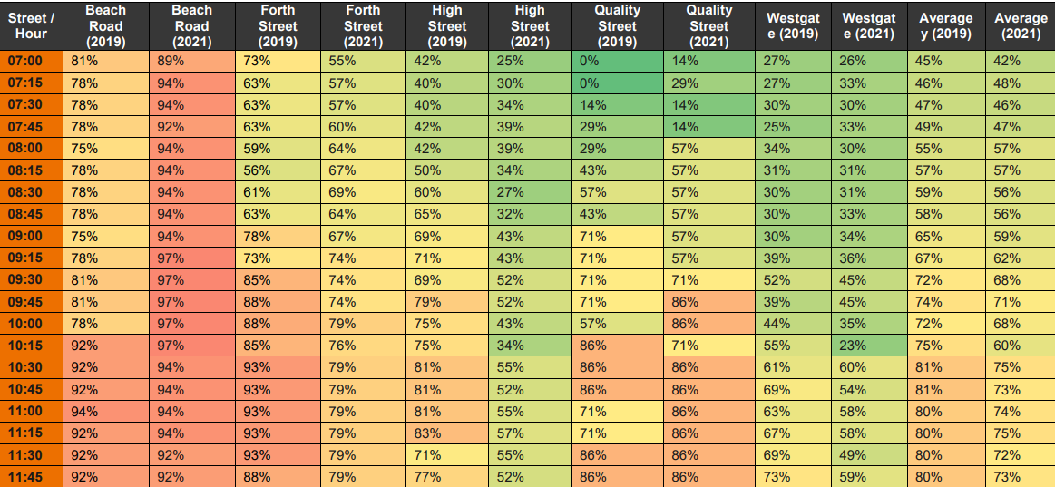
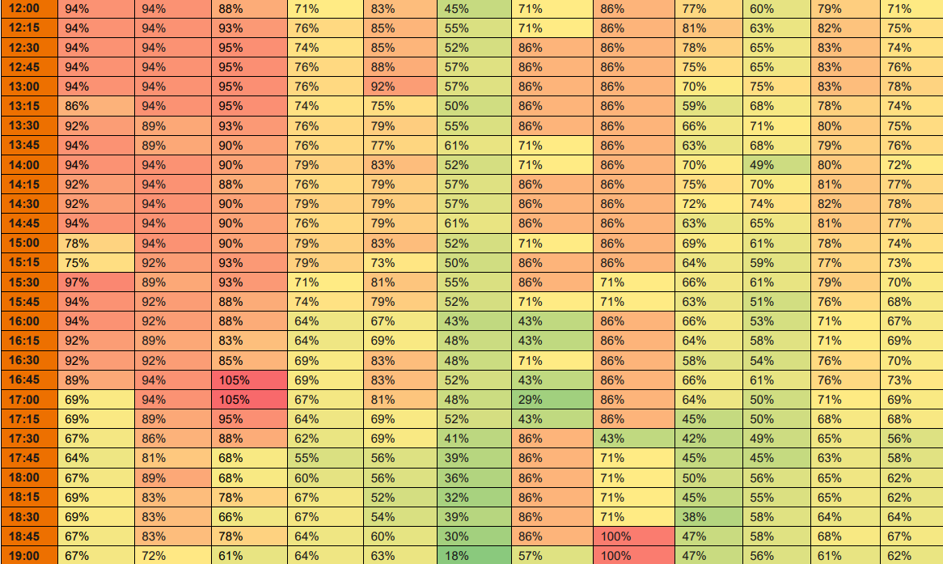
The Economic Impact Assessment - Occupancy
Average Occupancy of Parking Spaces
Beach Road highest with 81% / 89% at 7am – how many of them will still be there in the future, because they have parking permits? Most of them!

Slide 16
The Economic Impact Assessment - LTS
Reference to the Local Transport Strategy: “Key Point: The strategy highlights the need for parking intervention as a measure to encourage modal shift and to promote better travel behaviours” and the CPZ scheme is meant to be an incentive to use more sustainable travel choices, but:
No additional public transport is provided to provide alternatives to car use for people living outside walking distance to their destination.
The use of bicycles is in a town with NB’s topography only possible for the youngest and fittest.
And only some of the young and fit living in the vicinity of the town centre may be encouraged to walk more often rather than to use their car.

Slide 17
The Economic Impact Assessment
Identified Problems - 1
Significant seasonal parking problems linked to tourism. Insufficient on and offstreet parking supply and poor turnover of spaces leading to on-street overflow parking affecting residential parking
Note the word seasonal (again)!
On-street overflow parking around The Glebe car park and North Berwick railway station
Both will get worse, just move a bit further away
Lack of enforcement of parking restrictions leading to deliberate violation
Yes, we will get more parking wardens

Slide 18
The Economic Impact Assessment
Identified Problems - 2
Lack of provision for long-stay parking creating long-stay on-street parking
No new long-stay parking created, so problem only moved to residential street
Lack of Blue Badge parking on High Street
Not a single new space in this TRO
Retailers experiencing difficulties with deliveries including abuse of loading bays and double parking on the carriageway
The only protection against that is the increase in parking wardens (but retailers get even fewer loading bays in the East End)

Slide 19
The Economic Impact Assessment
Identified Problems - 3
Signage to off-street car parks could be improved
Is there any provision for that in the TRO?
Short-term on-street problems at peak school travel periods around schools
Not at all affected by the TRO

Slide 20
The Economic Impact Assessment
Charrette
Reference to the Charrette:
“Key Point: The North Berwick Charette identifies parking problems within the town and also identifies socially acceptable interventions”
→The main Charrette recommendation for the East End of the High Street is to be thrown out!

Slide 21
The Economic Impact Assessment – Impact on shops
6.4.2 A key concern for local businesses is that parking restrictions and any reduction in parking spaces as a consequence of proposals on the east end of the High Street will lead to financial loss as the market share for cyclists and pedestrians is much lower. This is due to perceptions that most visitors to shops travel by car rather than walking or wheeling.
6.4.3 However, the evidence suggests that retailers over-estimate the contribution of drivers to footfall.
Question: And where is this evidence from?????
Answer: From Bristol, where 42% of customers lived within half a mile,
not 12% as retailers believed,
and Toronto, where 10% of customers arrived by car –
like comparing NB with London!

Slide 22
The Economic Impact Assessment
Estimated Mode Shares in 10 Scenarios
(Quite apart from the very small changes in mode share, the “Assumed Modal Shift” appears to be total nonsense)

Slide 23
The Statement of Reasons

Slide 24
Introduce appropriate areas for a small number of visitors to make overnight stops in motorhomes
The order mentions allowance for overnighting motorhomes in designated bays on Sewage Works & Haugh Car Park, but provides no further details on number of bays, charges or appropriate facilities.
Overnight parking for high vehicles allowed in most parts of the CPZ, the only one excluded is Tantallon Terrace from Sewage works to Glen Clubhouse!
We feel: motorhomes should only be allowed on dedicated camp sites, not in front of resident’s homes, but there are numerous locations where there are no height restrictions for overnight parking

Slide 25
Reduce inappropriate and indiscriminate parking which can cause inconvenience and congestion
The only way to reduce inappropriate parking is the increase in parking wardens,
but nothing in the CPZ scheme itself

Slide 26
Enable better management of the limited parking space available in the town
The CPZ scheme does not create any additional parking space, but only reorganises the existing space.
Parking space is more limited than demand requires only in the peak summer months. There is not a shred of evidence that there is a shortage of parking spaces all year round.
During the summer the main parking problems are created by visitors coming for much of the day to go to the beaches, and then also go into town for a stroll or an ice cream or a meal. These visitors therefore currently do not make much use of any parking spaces in the High Street, but use space in residential streets or by the recreation park. This will not change. But the prospect of being charged for parking will make many visitors think twice about coming to NB, and stay in Gullane or Portobello instead.

Slide 27
Provide convenience and improved parking opportunity for residents who are currently affected by high demand for parking spaces at peak times
In the original survey more than two thirds of the respondents, who lived within a future CPZ, rejected the CPZ concept! They clearly do not perceive the proposal as an improvement to their current situation.
Only very few streets have purely residential parking, amounting to 683 m in total providing space for just over 100 cars on total, mainly around the train station.
The vast majority is combined parking for residents and charged parking.
Residents in the East Zone have no advantage whatsoever by paying £40, because all spaces there are for combined parking, and the parking permits do not even allow use of the Imperial or Lodge car park.
Furthermore, in the East Zone there is no limit to parking duration, only a maximum daily charge of £5.00 allowing visitors to stay all day (including camper vans in some streets).

Slide 28
Increase turnover of vehicles parking in the town, providing easier access to businesses and shops - 1
High Street
The existing 90 minute limit still applies.
45 minutes are free, the next 30 mins cost £1.00 and the next 15 minutes another £1.00. This is very limited incentive to increase turnover, when the current average parking time during business hours is already below 25 minutes.
Capacity increases in Imperial and Lodge with 64 and 23 spaces changing from long-term to 90 mins, mainly at the expense of residents
Reductions in turnover:
The extension of the permitted parking time in the Kirk Ports car park from 60 to 90 minutes will decrease turnover;
The extension of the permitted parking time in the Glebe car park from 3 hours, as had been previously introduced, to 5 hours;
In Westgate 80 spaces changing from the current 90 min limit with a current average parking duration under 40 minutes replaced by combined permit and paid 6 hour parking.

Slide 29
Increase turnover of vehicles parking in the town, providing easier access to businesses and shops - 2
The need to get a parking ticket even by app will add a couple more minutes to each stay and, for those having to get a ticket from a machine, even for a quick errand, will not only add even more minutes to the parking time, but deter many from coming to the High Street in the first place, and go to Aldi or Tesco, or order from Amazon instead.
The scheme will increase turnover to some extent by preventing High Street employees parking near their place of work all day, but this will make it even more difficult for anyone outwith walking distance to be able to take on a job in North Berwick town centre, when local business is already fighting with staffing problems.

Slide 30
Increase turnover of vehicles parking in the town, providing easier access to businesses and shops - 3
In Berwick-on-Tweed the introduction of parking charges killed the town centre, and has since been revoked – but too late to save the centre
2 hours free parking has been re-introduced in Ayr Town Centre ‘to help increase footfall in the town and boost the local economy’.
Aldi and Tesco are easy alternatives for food shopping
Amazon delivery vehicles are already noticeable all over the place
One High Street shop is already empty and Trespass is closing down as well
A number of High Street retailers have already announced they will not extend their lease, if this scheme goes ahead
The risk that our High Street, now the “Jewel of the Crown”, reverts back to the poor state it was in 20 years ago is very real.

Slide 31
Increase turnover of vehicles parking in the town, providing easier access to leisure facilities
Access to the West golf course for members living outside walking distance will be severely impacted by a charge of £6.00 for every round of golf. For members playing twice a week the charge will amount to £600.00 per year. Which is not easily affordable for everyone!
Access to swimming pool and leisure centre could be reduced when day visitors use that car park in the summer months, when the recreation park is full, as one of the nearest places, where they can stay without charge.

Slide 32
Not Considered in Statement of Reasons - 1
3 parking zones with all different rules and regulations will be confusing for residents, but even more so for visitors, and many inadvertent violations are to be expected.
Guest of residents in CPZs will have to pay for parking, possibly discouraging visits, with the infirm and elderly possibly worst affected. In other CPZs it is usual that residents have passes that can be filled in for their guests’ cars.
Machines to pay for parking will be obstacles on the pavement.

Slide 33
Not Considered in Statement of Reasons - 2
The station car park will be permanently full with residents without permits, their guests and other visitors. Train users will find it impossible to park there for much of the time, and commuters cannot even pay for parking in the vicinity due to the 6 hour limit. They will therefore have to park way up Glenorchy Road, Ware Road, or Highfield Road, and possibly miss their train, if they have to walk even further than expected, and in any case make train access very difficult for people with mobility issues,
There will be severe spillover effects on roads just outside CPZs. Streets like Glenorchy Road, Ware Road, York Road, and in particular St Baldreds Road, will become parking hot spots, which will not only create new problems for residents there, but, even worse, certainly create severe problems for access to the surgery.

Slide 34
In short:
This proposal tries to kill a fly with a large rock that will kill much more than that fly!

Slide 35
Where to find the Traffic Order:
https://northberwickparking.commonplace.is/en-GB/proposals/document-library/step1
How to object:
Any objection must be in writing and must specify the grounds thereof and should be addressed to:
North Berwick Parking Management TRO, Asset and Regulatory Manager, Road Services, Penston House, Macmerry EH33 1EX
Or Email
roadsconsultation@eastlothian.gov.uk quoting reference North Berwick Draft TRO by 22nd October 2023

Slide 36
Contacts for local ELC Councillors:
Jeremy Findlay – jfindlay@eastlothian.gov.uk
Liz Allan – lallan2@eastlothian.gov.uk
Carol McFarlane – cmcfarlane1@eastlothian.uk

